Slide 1


USA REAL ESTATE
Data Analysis
Team 6 2022/12/26

Slide 2
01
Introduction
CONTENTS
02
Data Analysis
03
Difficulties

Slide 3
01
Introduction
USA has one of the hottest real estate markets right now. We deduct a housing dataset with various factors in order to forecast and evaluate the real estate market.

Slide 4
Introduction - Data information
8 variables:
price
bed price
bath
acre_lot
Raw Data: https://www.realtor.com
Scrapped Data: Kaggle
city
state
zip_code
house_size
02
04
Source
Size
Variables
Values
01
923,160 observations
03
mean: 884,123
median: 475,000
mode: 299,900
s.d: 297,437

Slide 5
Introduction - Smart Questions
What is the correlation between house price and other attributes?
Which is the most significant factor to be considered in different house prices?
01
02
03
04
Which location contains the house with the highest and lowest prices?
Do the mean values of price get affected by beds and baths?
04

Slide 6
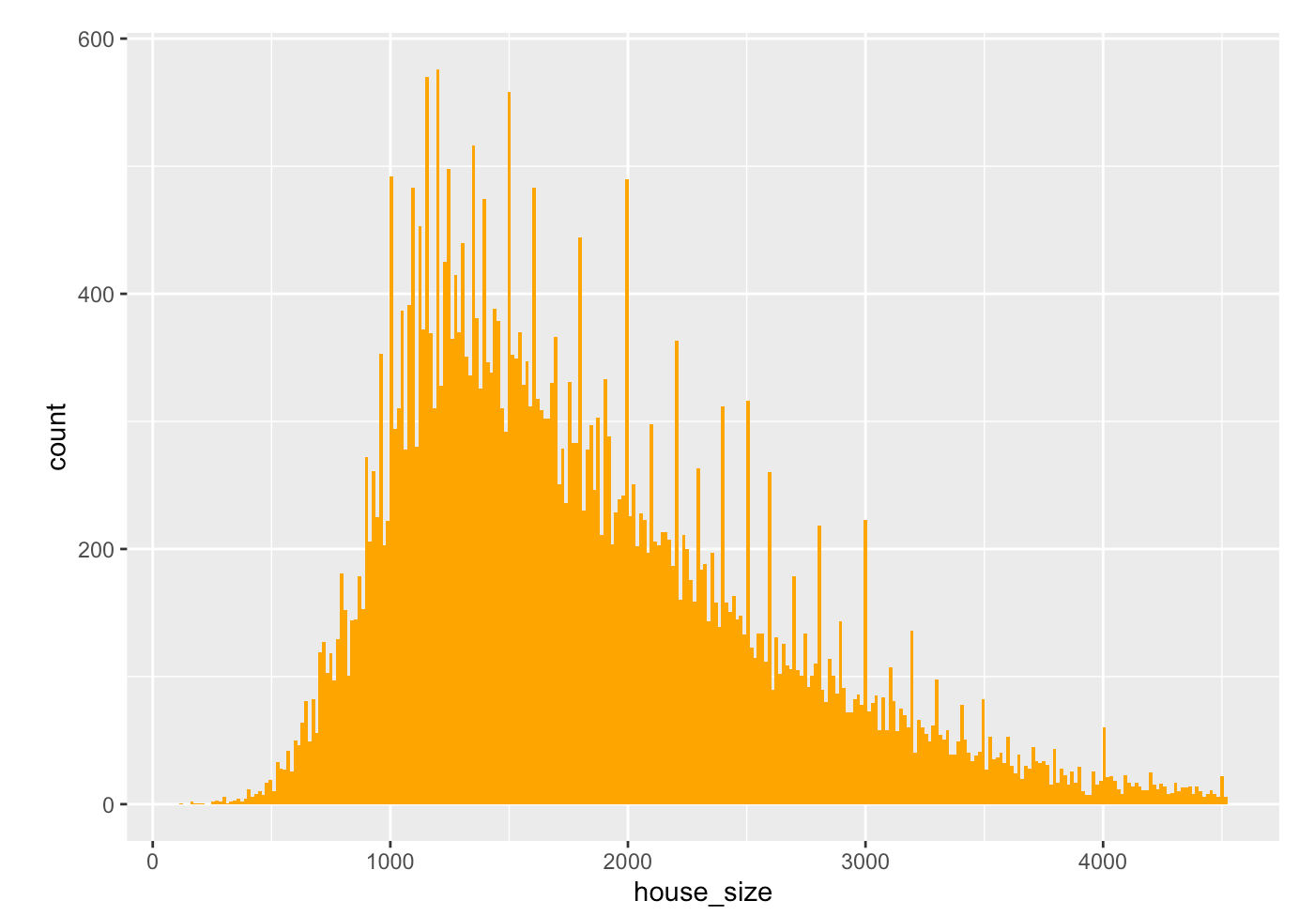
Data Overview:
The histograms for the house size indicates that most of the house size is between 1200 to 1400. Here, we can observe from the data that there are more average size houses compared to bigger size or smaller sized houses.

Slide 7
02
Data Analysis
Preprocessing
Correlation Analysis
Tests

Slide 8
Data Analysis- Steps in Data pre-processing
2 variables are dropped: status, and sold_date
The total number of beds, baths and state are converted into the categorical type by using the as. factor() function.
Checked whether any duplicate rows are present in the data frame, and these duplicate rows are removed from the data frame.
By using the outlierKD2() function, all the outliers in the data frame are removed.

Slide 9
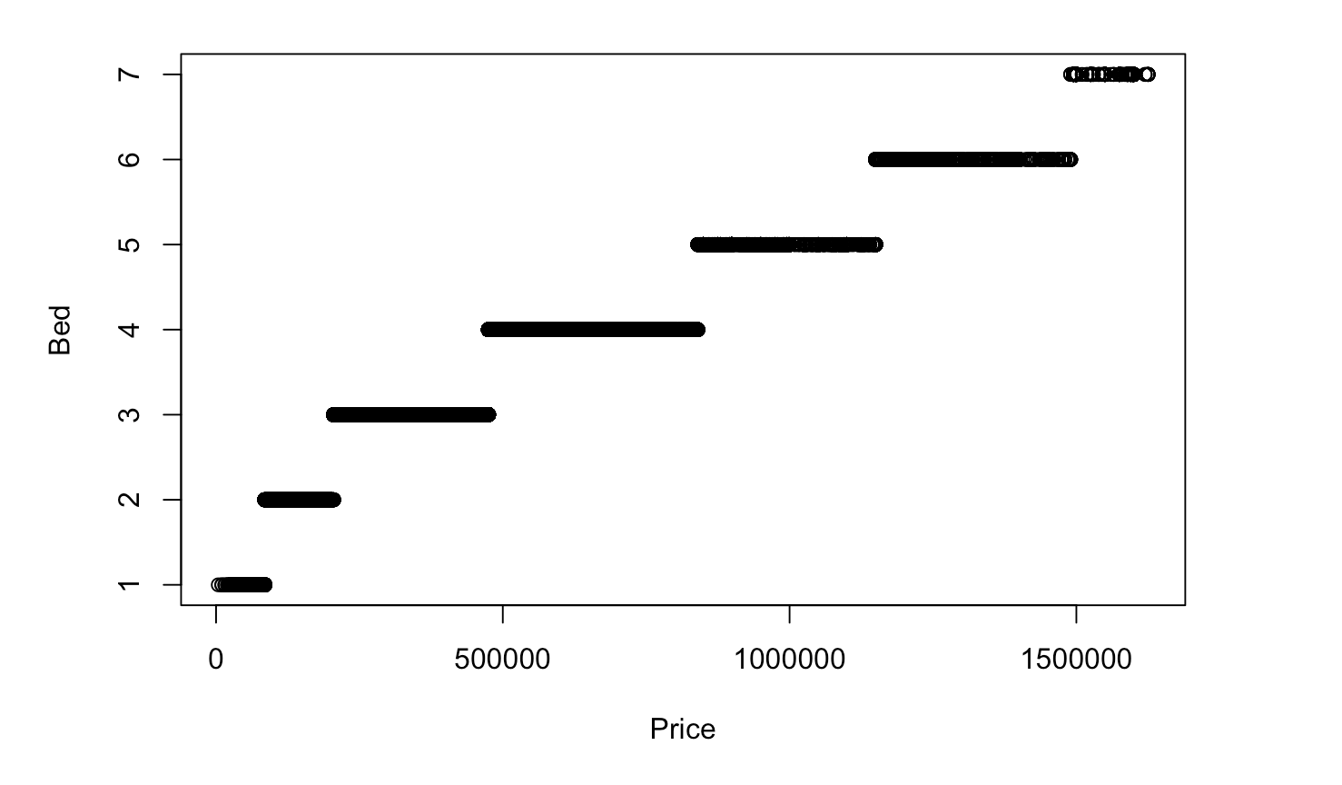
Data Analysis- Bed vs. Price

Slide 10
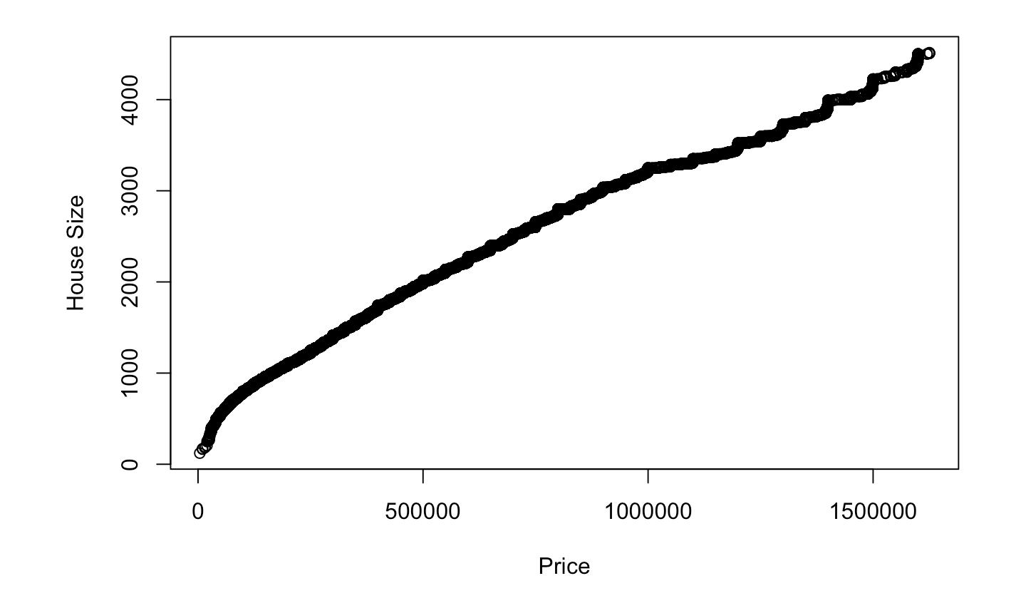
Data Analysis- House size vs. Price

Slide 11
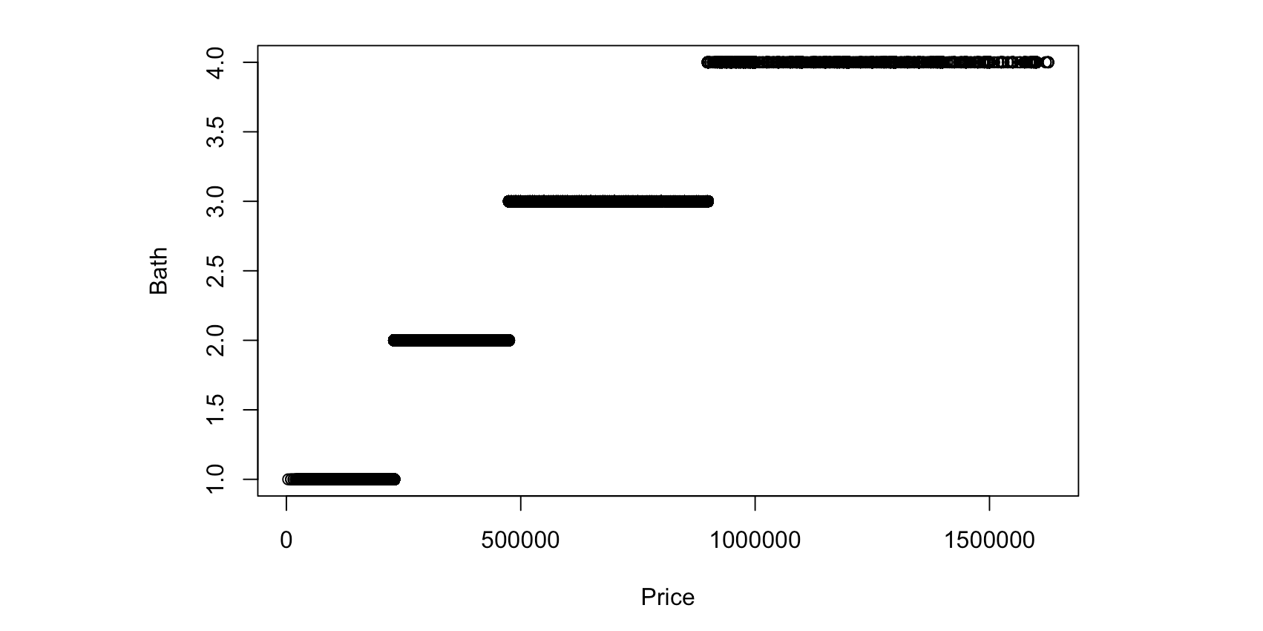
Data Analysis- Bath vs. Price

Slide 12
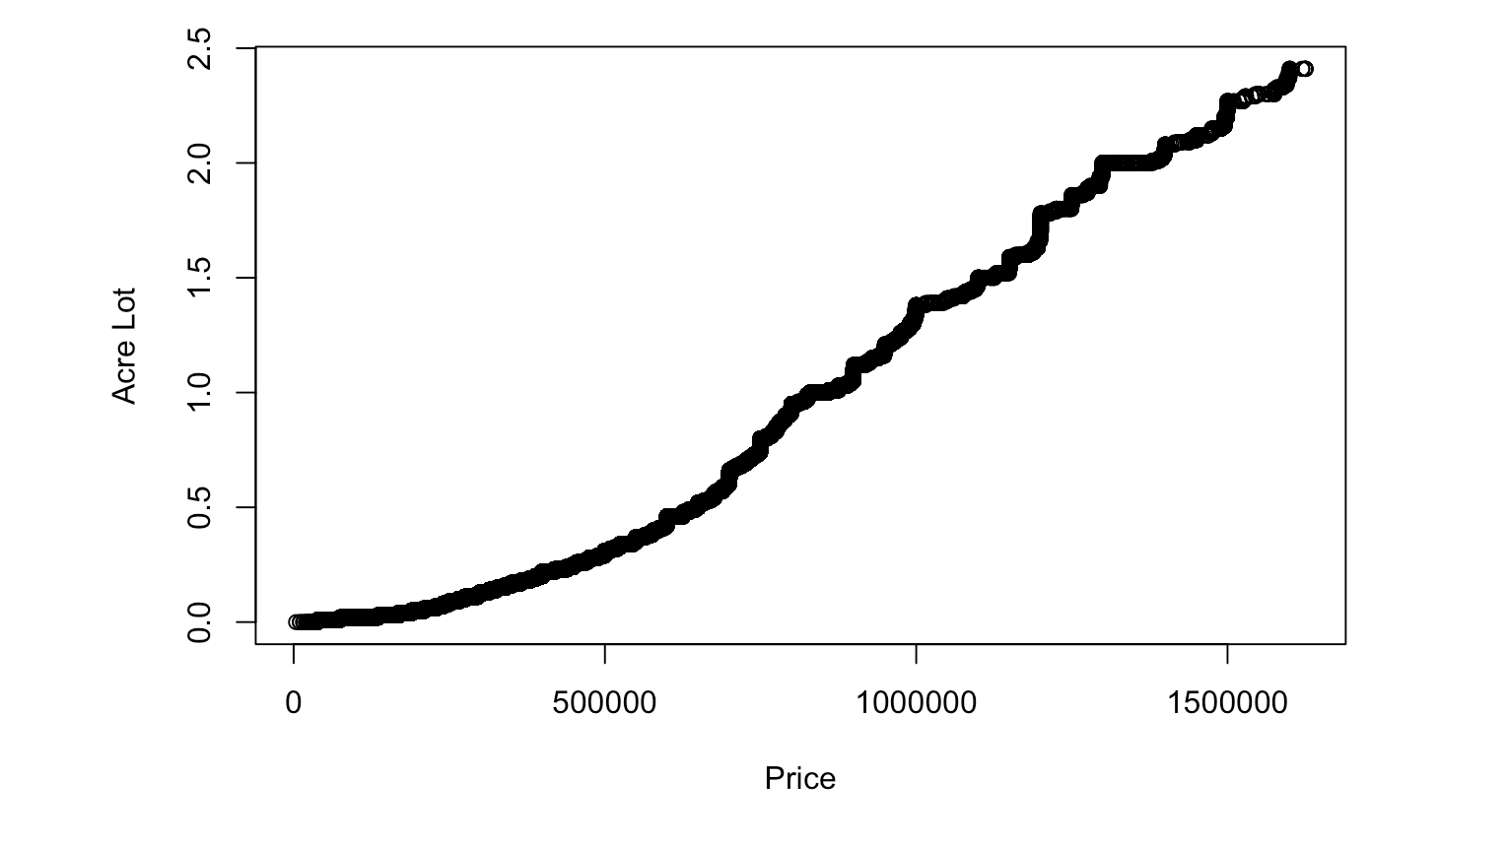
Data Analysis- Acre Lot vs. Price

Slide 13
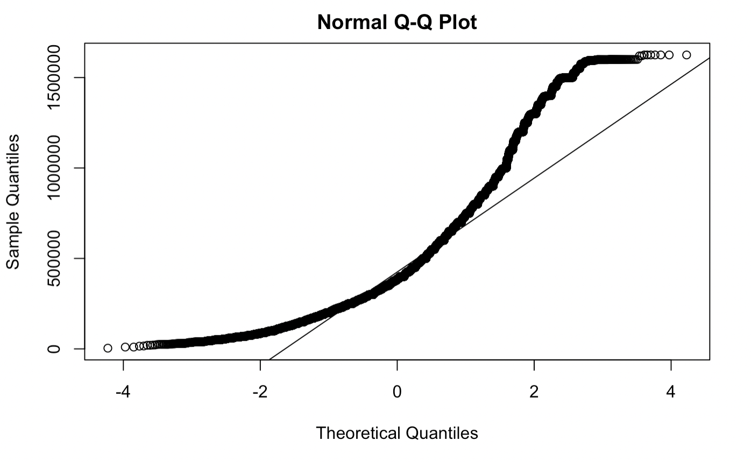
Data Analysis- QQ norm (price)

Slide 14
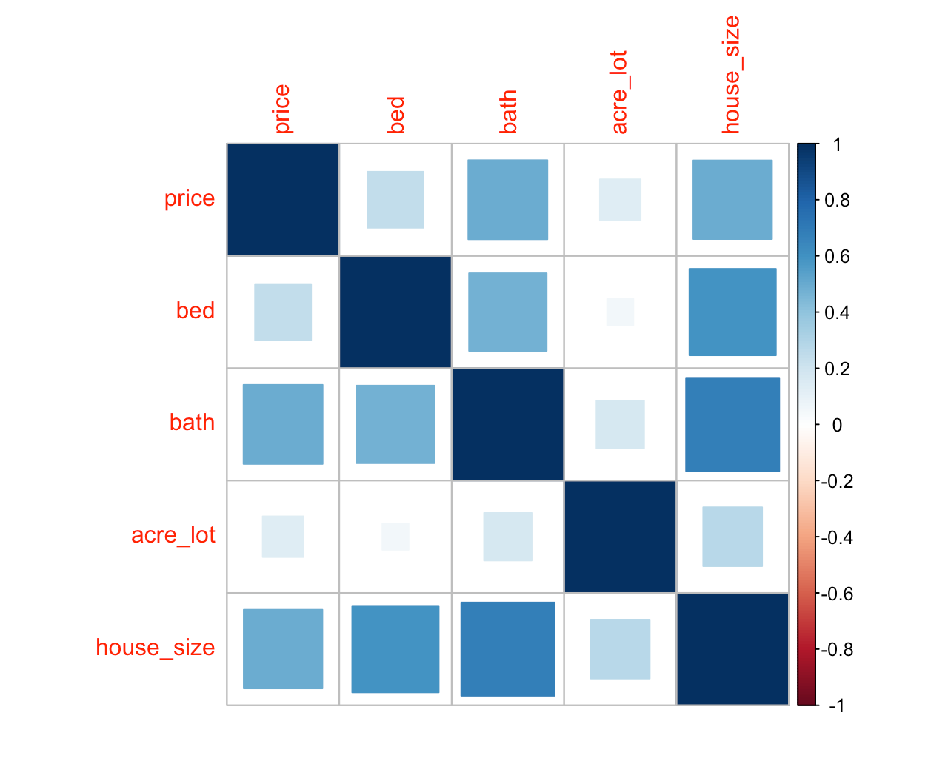
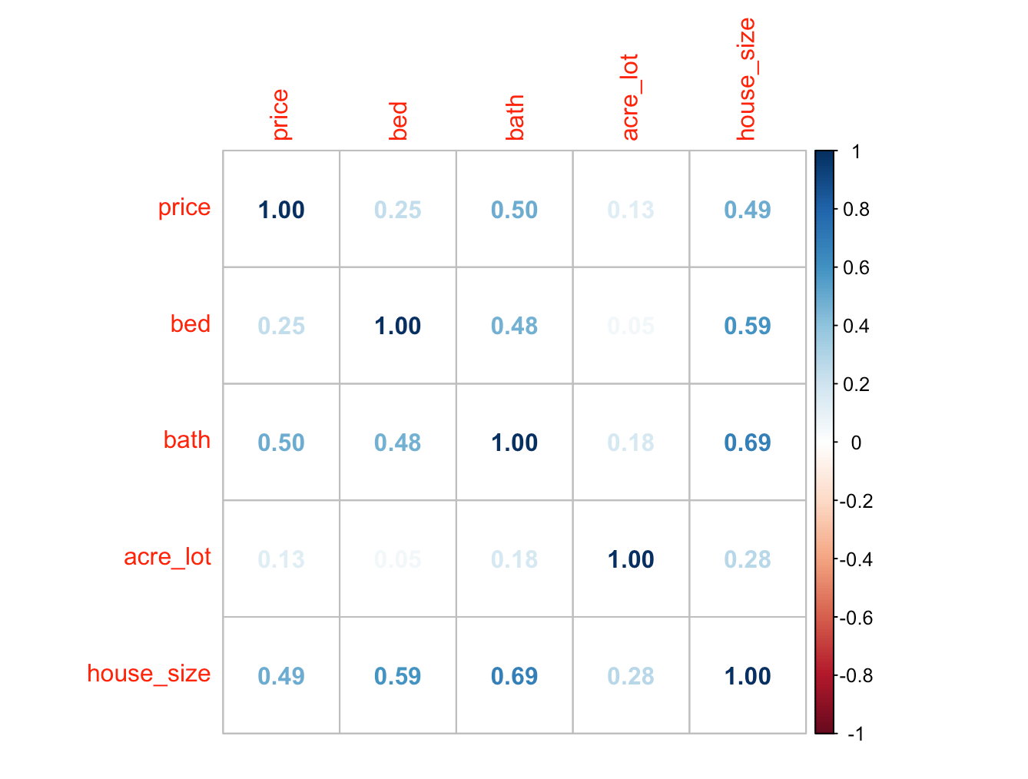
Data Analysis- Correlation Analysis

Slide 15
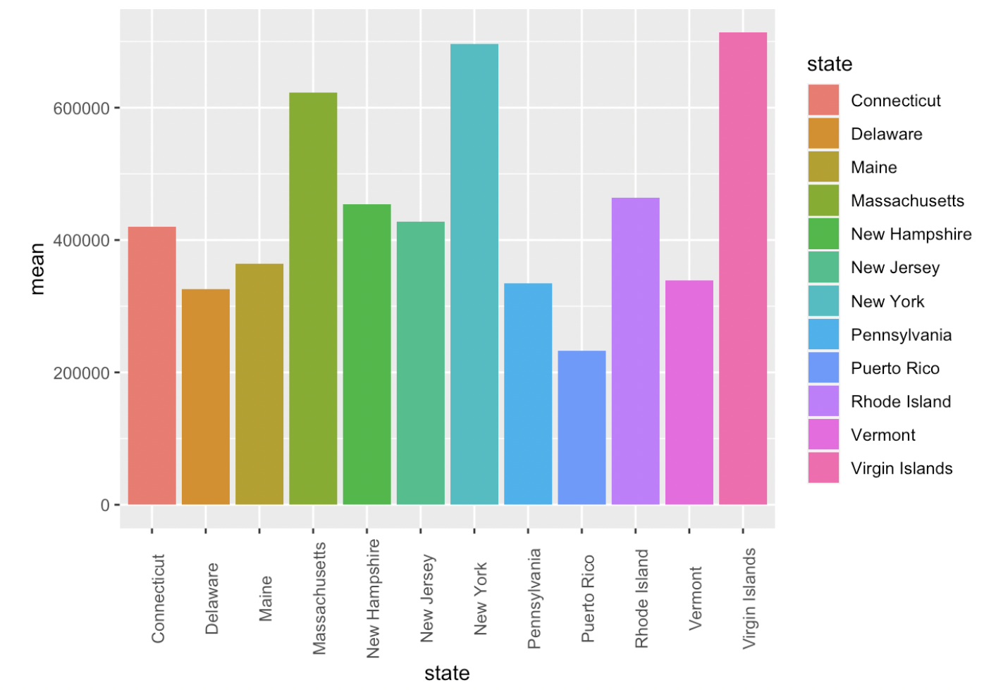
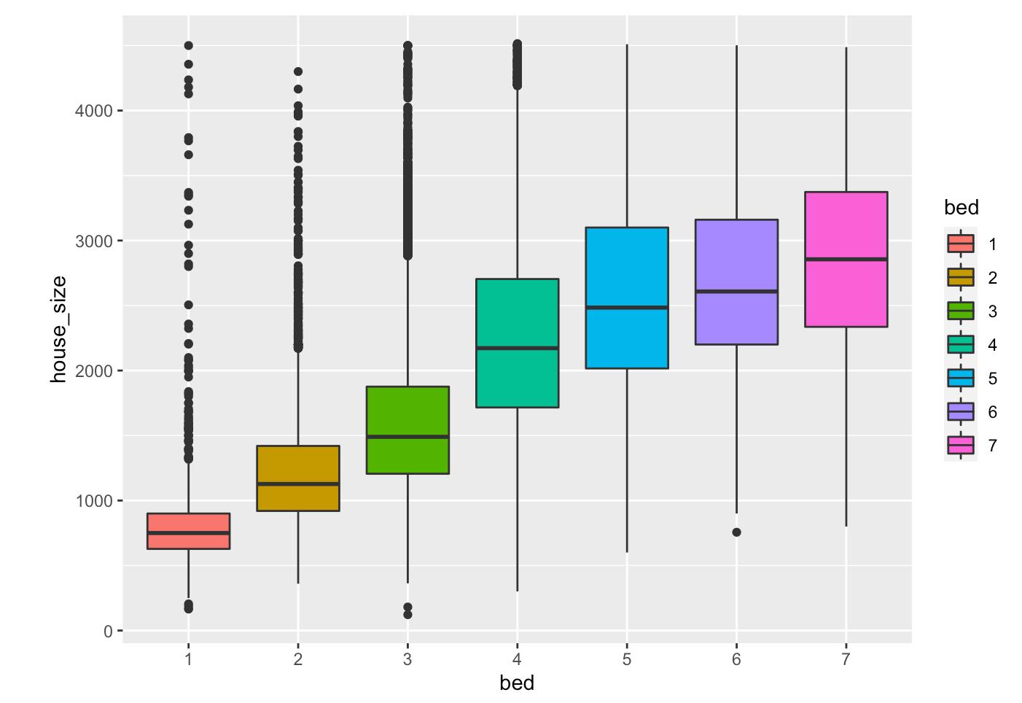
Data Analysis- Barplot Evaluations

Slide 16
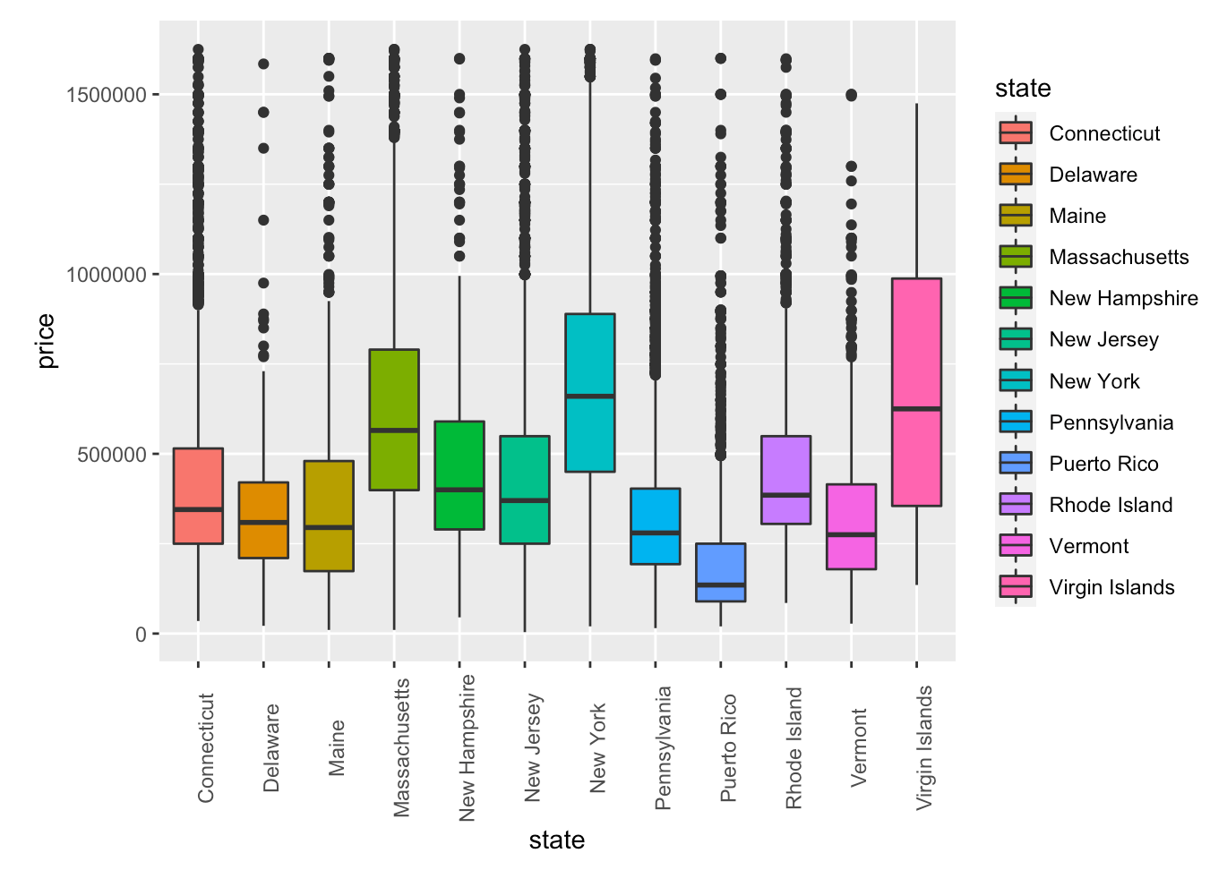
Data Analysis- Boxplot Evaluations

Slide 17
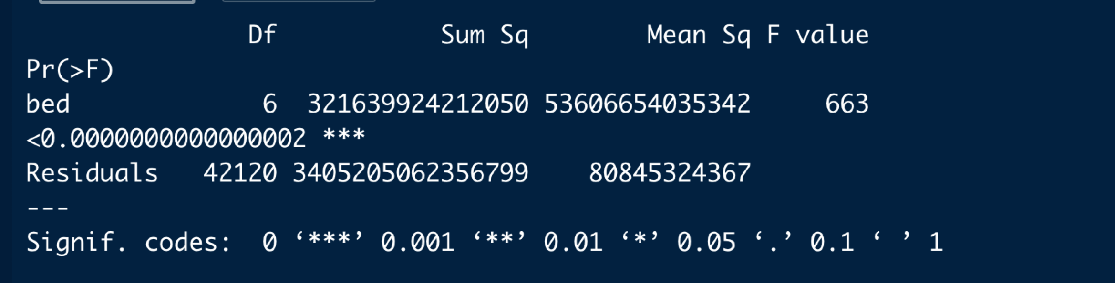
Data Analysis- Anova Test
ANOVA TEST FOR PRICE AND TOTAL NUMBER OF BEDS
anova_hb <- aov(price ~ bed, data= df)
The ANOVA test for the house price and the number of beds indicates that as p-value is less than 0.05. So we need to reject the null hypothesis, and the mean price of the houses is different for the number of beds.

Slide 18
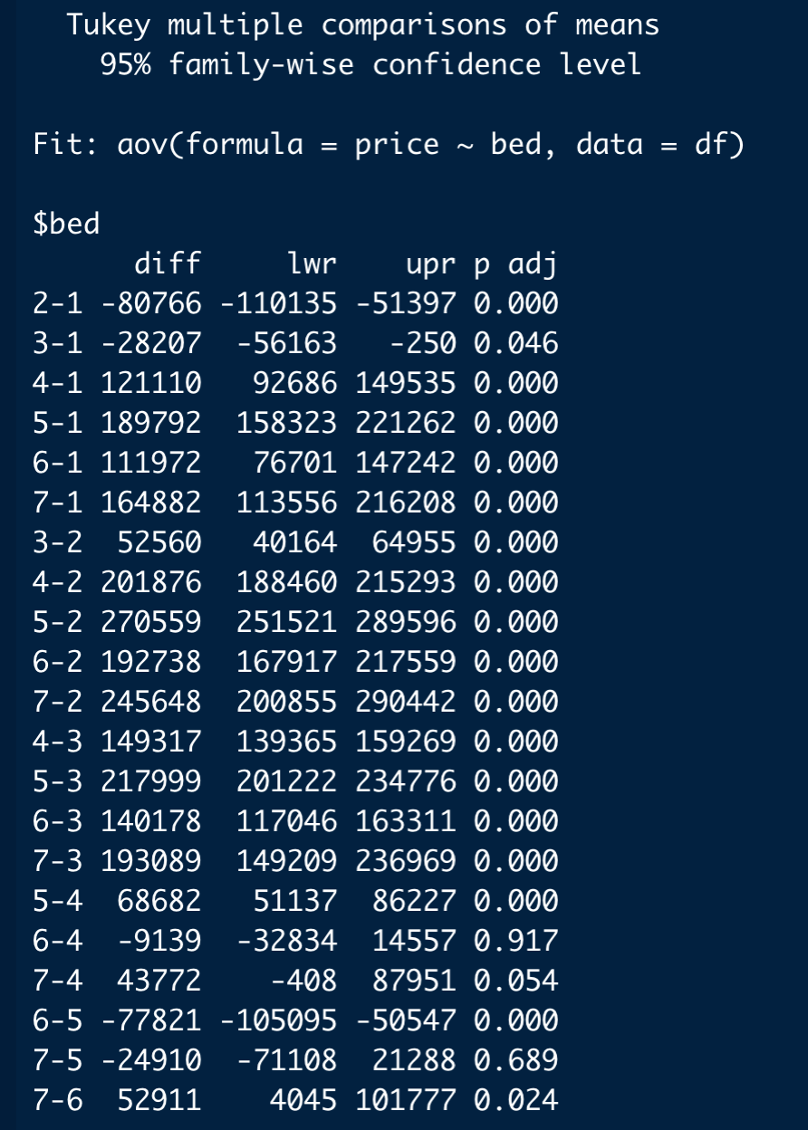
Data Analysis- TUKEY HSD TEST
As the means of the groups are significantly different, we can use the Tukey test for possible pairwise comparisons.
Expect 6-4 and 7-5 remaining comparisons are statistically significant at 95 percent confidence interval.

Slide 19
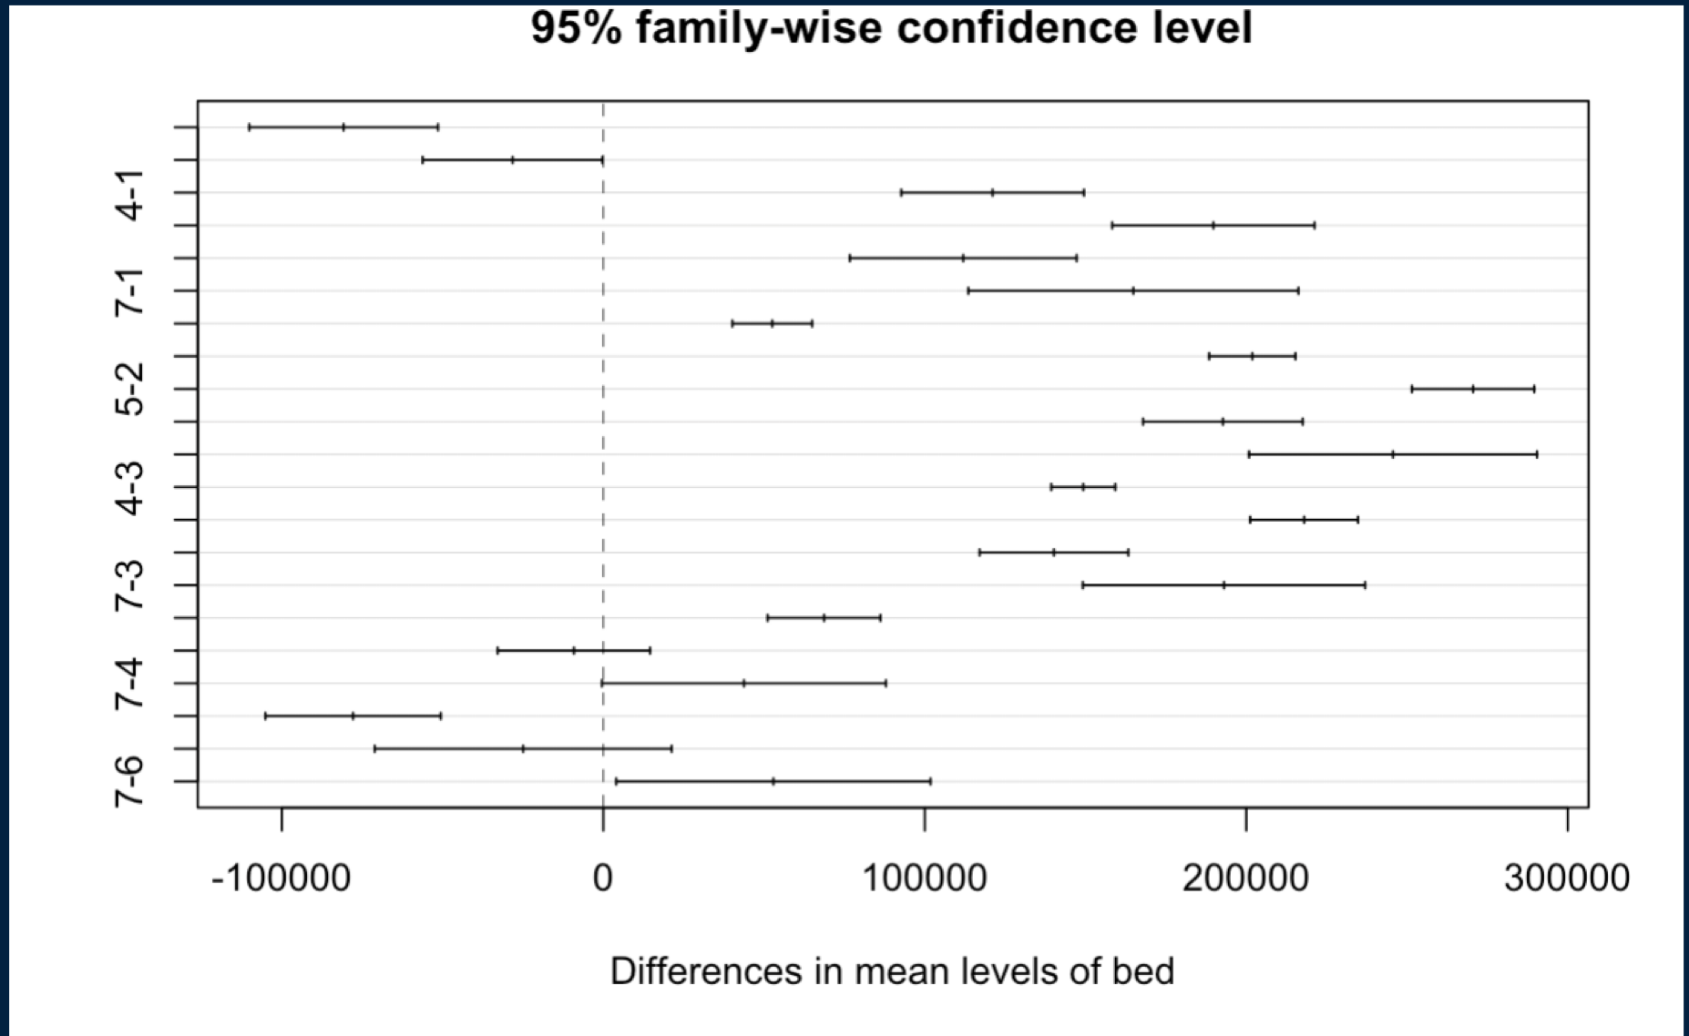
Data Analysis- TUKEY HSD TEST
plot(TukeyHSD(anova_hb, conf.level=.95))
The plot describes the difference in the mean values between the different levels of the bed.

Slide 20
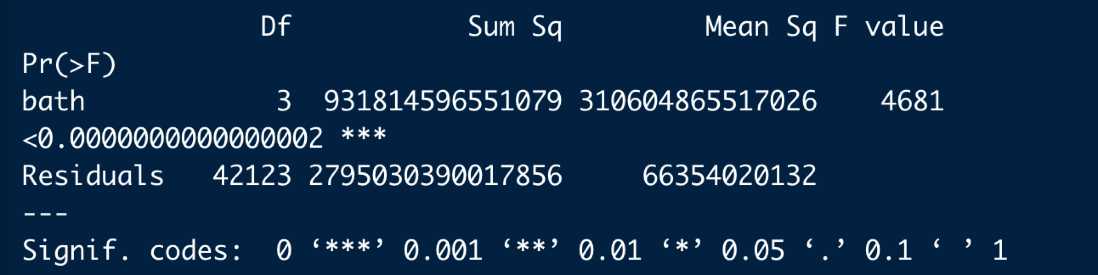
Data Analysis- Anova Test
ANOVA TEST FOR THE PRICE AND TOTAL NUMBER OF BATHS
anova_hbath <- aov(price ~ bath, data= df)
The ANOVA test for the house price and the number of bathrooms indicates that the p-value is less than 0.05. So we need to reject the null hypothesis, and the mean price of the houses is different from the number of baths.￼

Slide 21
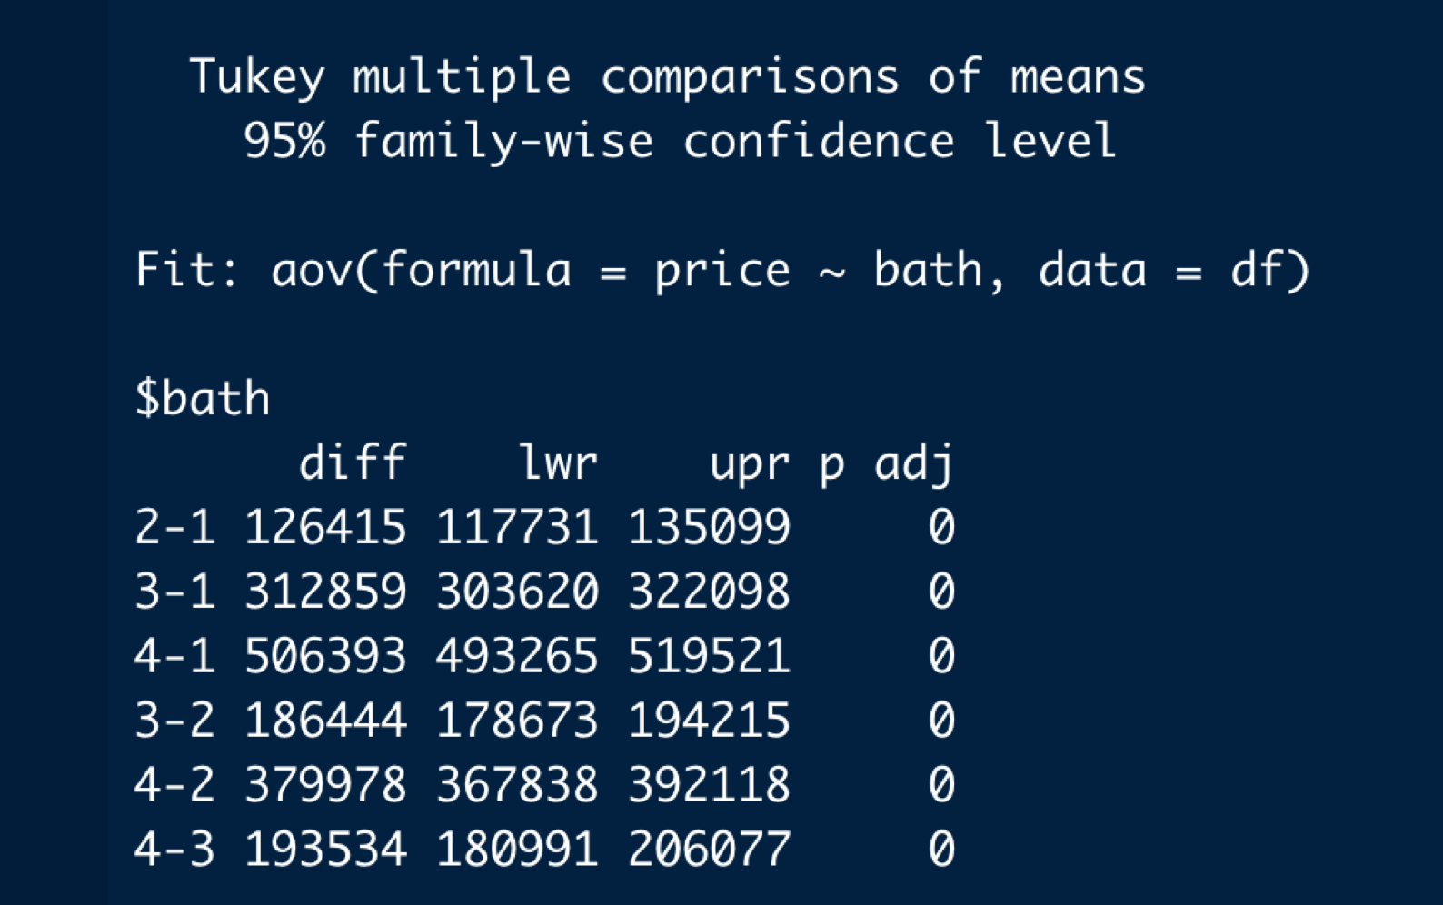
Data Analysis- TUKEY HSD TEST
tukey_test_hbath <- TukeyHSD(anova_hbath)
The pair-wise comparison between each group is statistically significant at 95% confidence interval.

Slide 22
Data Analysis- TUKEY HSD TEST
plot(TukeyHSD(anova_hbath, conf.level=.95))
The plot describes the difference in the mean values between the different levels of the bath.

Slide 23
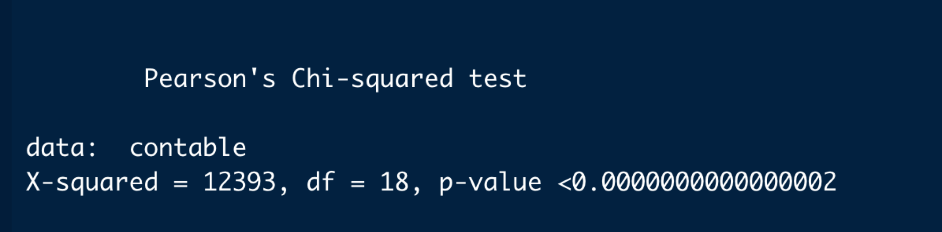
Data Analysis- CHI-SQUARE TEST
BETWEEN NO. OF BEDS AND BATHS
contable = table(df$bed, df$bath)
chitest = chisq. test(contable)
Since the p-value is lower than 0.05, so we need to reject the null hypothesis. Thus, condition and grade are not independent. Both the bed and bath are correlated.

Slide 24
03
Difficulties

Slide 25
Difficulties
There are multiple N/A values in different columns, if we remove all of those N/A data, there will be too few data set left. So, we choose to only remove the N/A for the columns we are discussing separately.
The data set we got is too big to put into GitHub.
We don’t have data for time, we can’t really do any prediction analysis there.

Slide 26
Question
Time

Slide 27
Thanks

